Slide 1
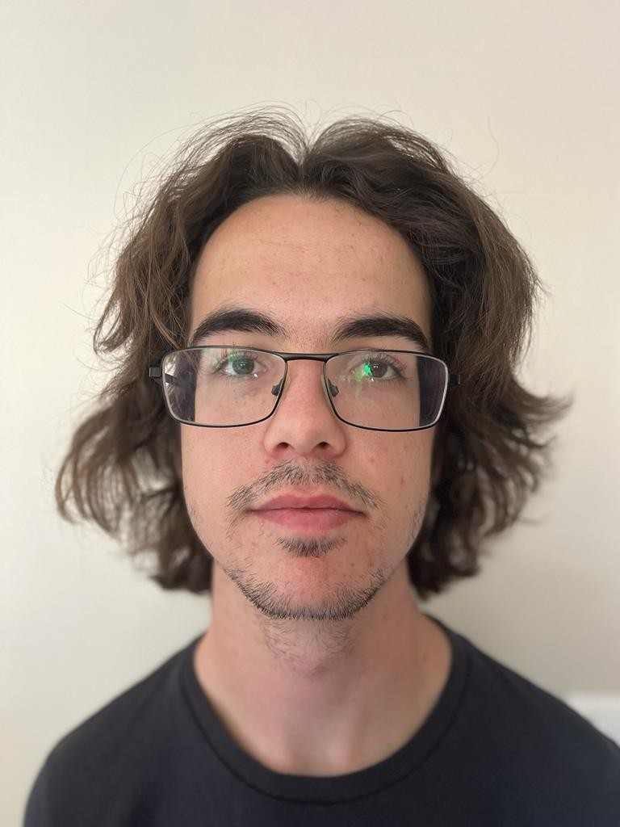

Chiara de lucia memorial fund
Meet your scholar
Meet Jonathan Phillips, your 2025 scholar. We caught up with Jonathan as he prepares for his research year at Surrey.
How did you feel when you got the news that you would be receiving the scholarship?
I am honoured to have been chosen to benefit from this scholarship, and I am excited to work on this project, as it is a topic on which I am very keen to work.
Thank you very much for the opportunity to continue Chiara's research on FLASH Radiotherapy!
Why did you choose this course and how do you feel about starting/are you enjoying studying at the University of Surrey?
I chose to study physics because I find the subject very interesting, especially thanks to my father. Studying at Surrey has been a brilliant experience. I've met plenty of wonderful people, and I have enjoyed my course throughout.
What is your background before doing this masters?
I come from the south of France, and studied there until I finished my Baccalaureate, at which point I moved to the UK to begin my degree at the University of Surrey.
Do you have any ambitions for the future?
I hope to help the world develop cleaner energy sources, such as nuclear fusion, to make the world a safer and healthier place.

